Slide 1
Interpreting Adversarial Robustness: A View from Decision Surface in Input Space ICLR 19’ Adversarial Weight Perturbation Helps Robust Generalization NIPS 20’
202111259 CSE 김수환

Slide 2

Contents
Abstract
Weight space loss, Input space loss
Decision surface
Adversarial robustness indicator
Abstract
Optimization problem
Weight Loss Landscape and Robust Generalization
AWP
Result
Conclusion

Slide 3
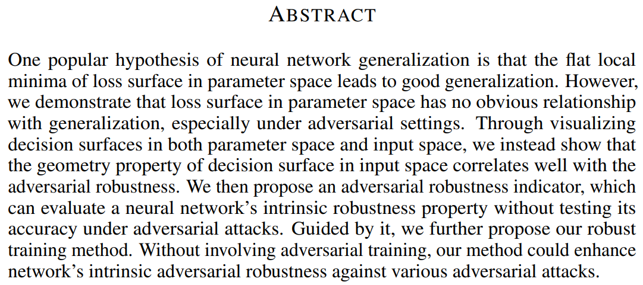


1. Abstract

Slide 4
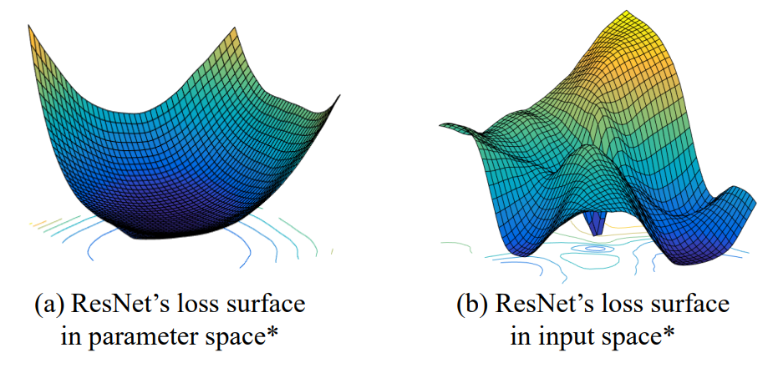
2. Weight space loss, Input space loss

Slide 5
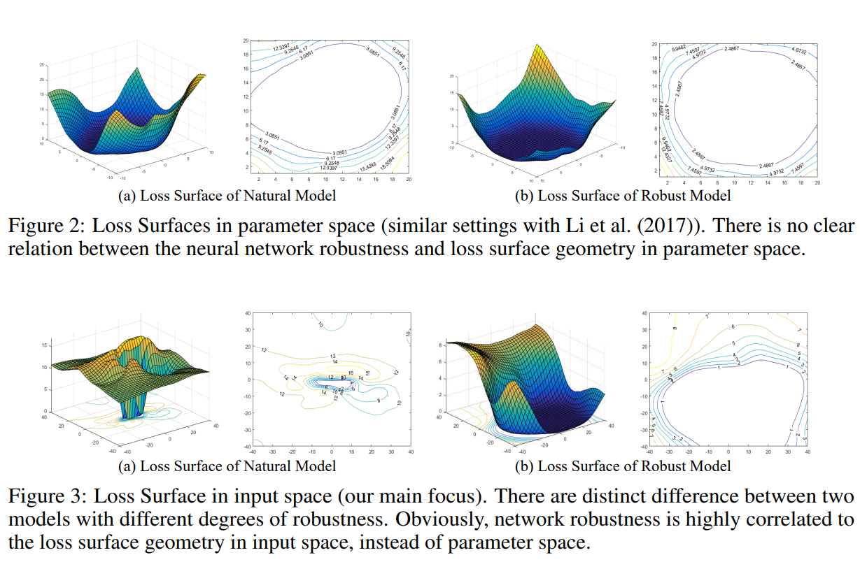
2. Weight space loss, Input space loss

Slide 6
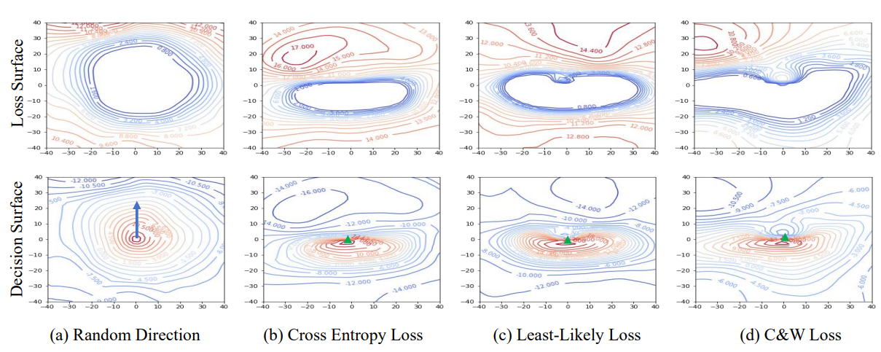
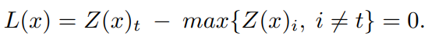
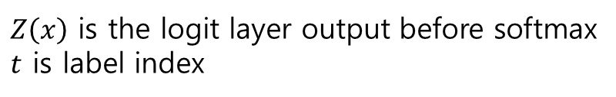
3. Decision surface
$Z\left(x\right)$ is the logit layer output before softmax
$t$ is label index

Slide 7
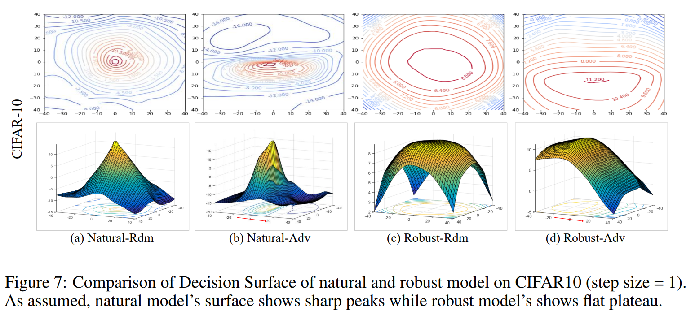
3. Decision surface

Slide 8
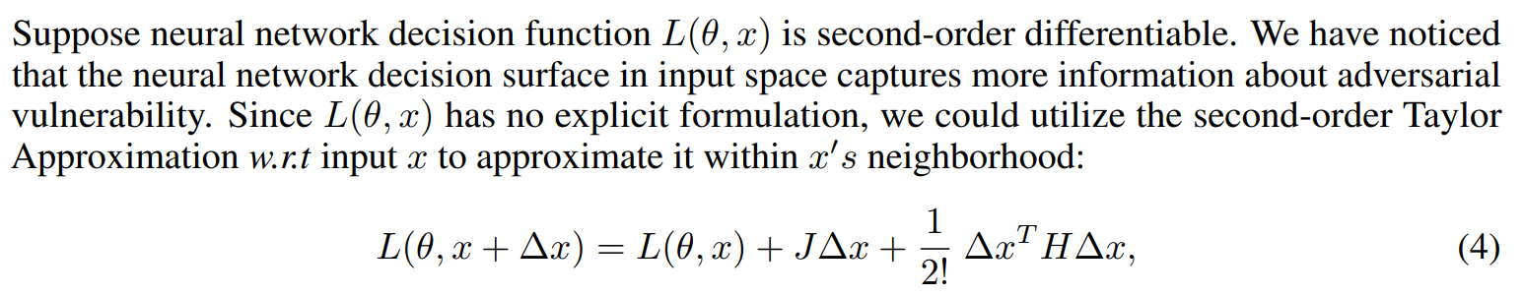
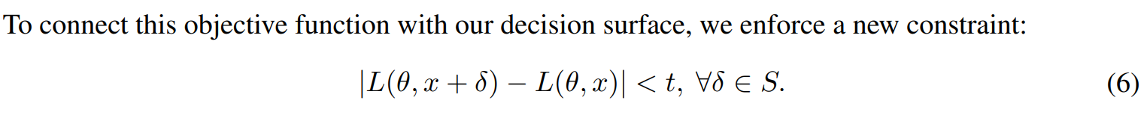
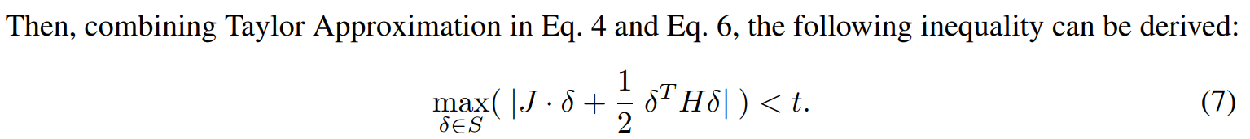
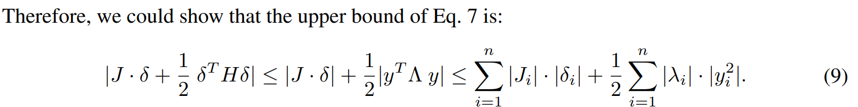
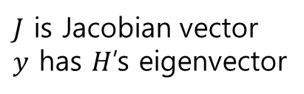
4. Adversarial robustness indicator
$J$ is Jacobian vector
$y$ has $H$’s eigenvector

Slide 9
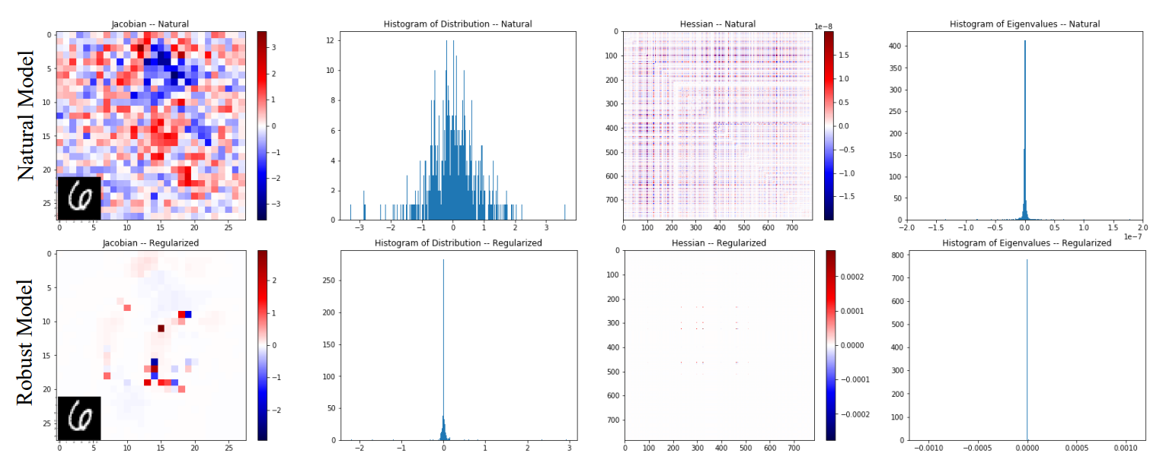
4. Adversarial robustness indicator

Slide 10
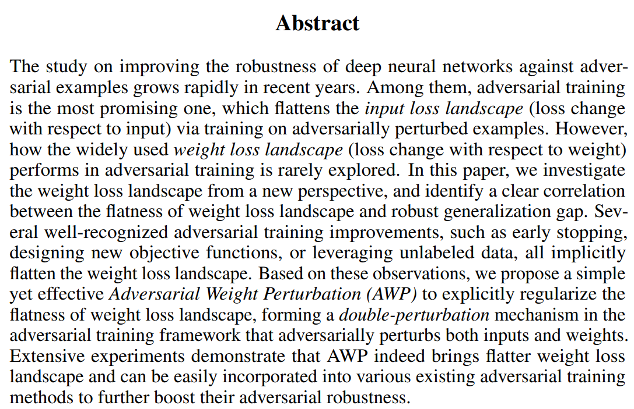





1. Abstract

Slide 11
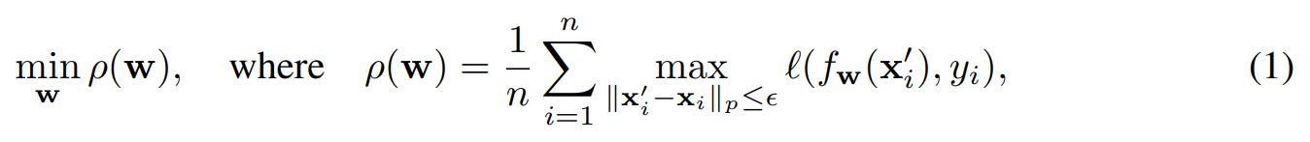
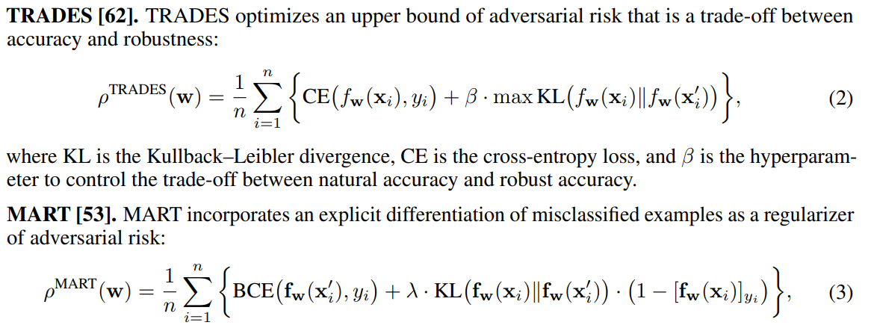
2. Optimization problem
Adversarial loss

Slide 12
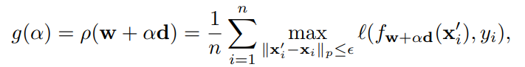
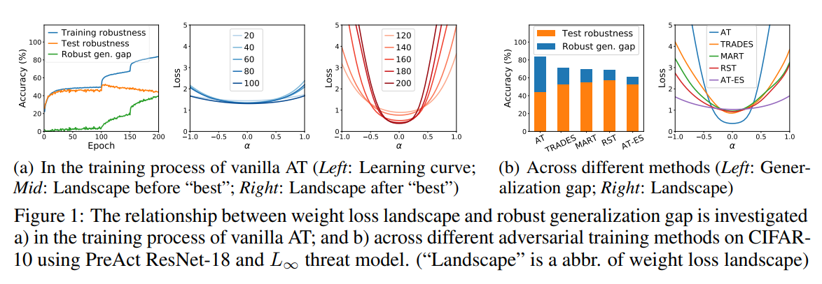
3. Weight Loss Landscape and Robust Generalization

Slide 13
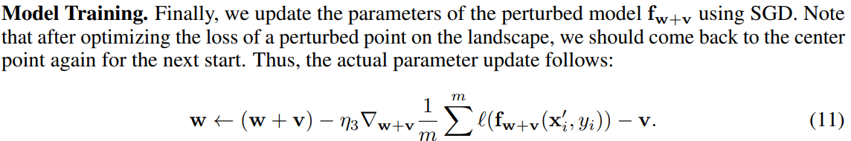
4. AWP
Weight, Input 축으로 모두 perturbation 줘서 학습
→ Robust generalization과 robust accuracy 모두 최적화

Slide 14
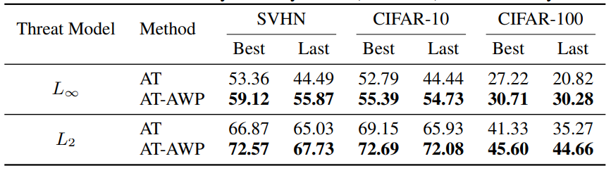
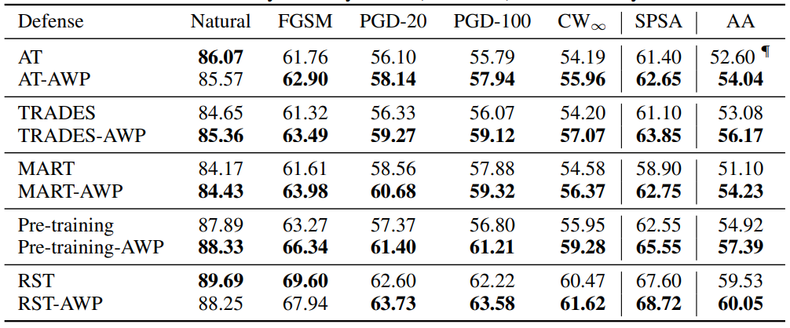
5. Result

Slide 15
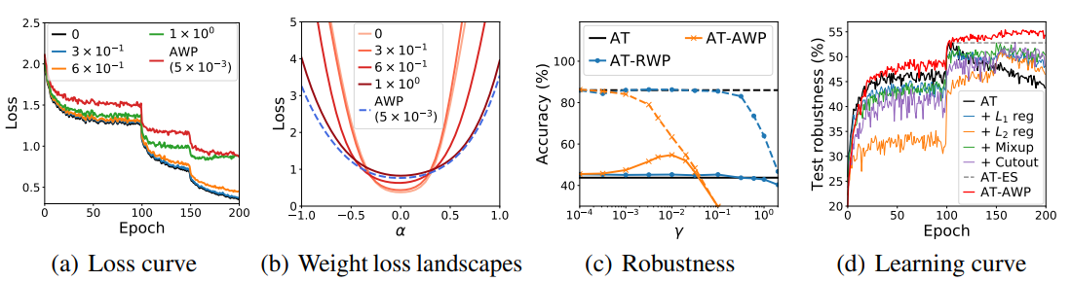
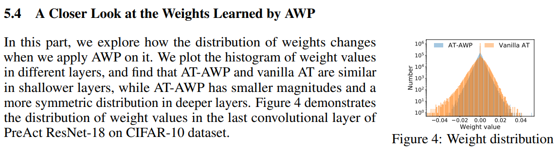
5. Result

Slide 16
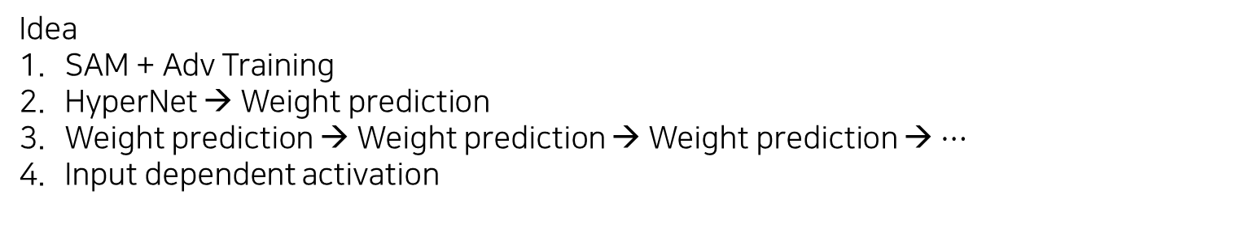
6. Conclusion
Idea
SAM + Adv Training
HyperNet → Weight prediction
Weight prediction → Weight prediction → Weight prediction → $⋯$
Input dependent activation

